Slide 1
Unit – 2 8 Hours
Introduction to the ARM Instruction Set: Data Processing Instructions, Branch Instructions, Software Interrupt Instructions, Program Status Register Instructions, Coprocessor Instructions, Loading Constants.
C Compilers and Optimization: Basic C Data Types, C Looping Structures, Register Allocation, Function Calls, Pointer Aliasing..

Slide 2
Introduction to the ARM Instruction Set :
The ARM Architecture is a Load/Store architecture.
– No direct manipulation of memory contents
– Memory must be loaded into the CPU to be modified, then written back out
• Cores are either in ARM state or Thumb state
– This determines which instruction set is being executed
– An instruction must be executed to switch between states
• The architecture allows programmers and compilation tools to reduce branching through the use of conditional execution
– Method differs between ARM and Thumb, but the principle is that most (ARM) or all (Thumb) instructions can be executed conditionally.

Slide 3
ARM instructions process data held in registers and only access memory with load and store instructions.
Example:

Slide 4
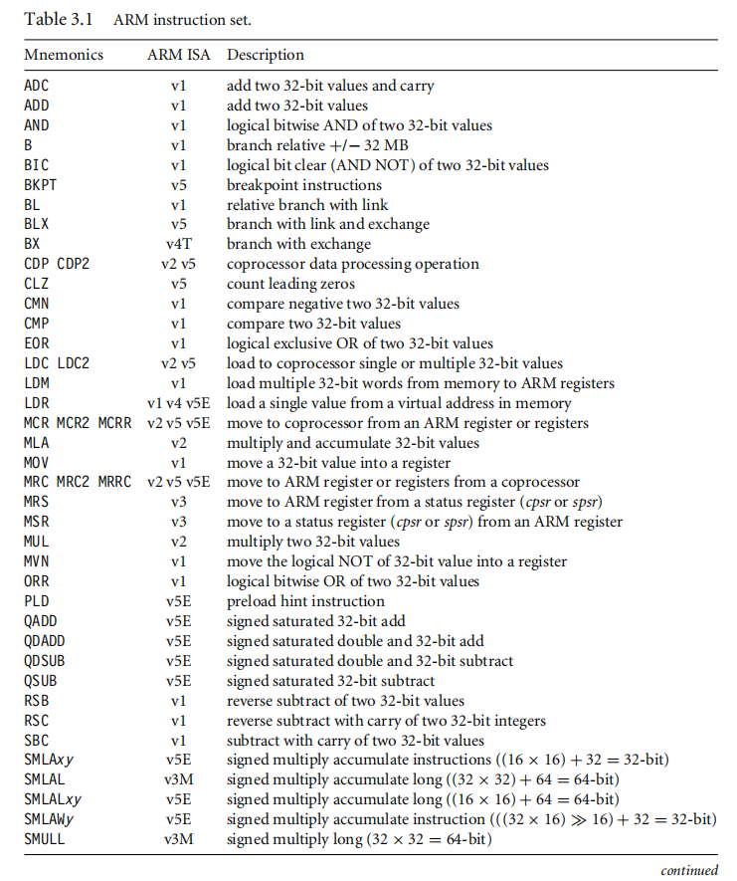

Slide 5
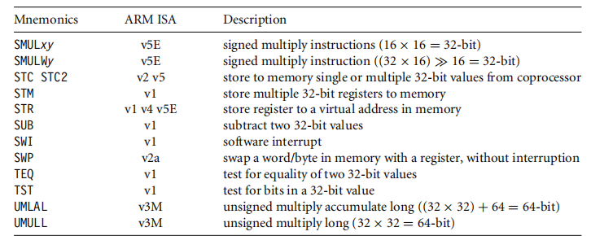
ARM instruction set. (Continued)

Slide 6
Data Processing Instructions
The data processing instructions manipulate data within registers.
Examples:
Move
Arithmetic
Logical
Comparison
Multiply
Most data processing instructions can process one of their operands using the Barrel shifter.
If you use the S suffix on a data processing instruction, then it updates the flags in the cpsr. Move and logical operations update the carry flag C, negative flag N, and zero flag Z.
The carry flag is set from the result of the barrel shift as the last bit shifted out.
The N flag is set to bit 31 of the result.
The Z flag is set if the result is zero.

Slide 7
Move Instructions:
Move is the simplest ARM instruction. It copies N into a destination register Rd, where N is a register or immediate value. This instruction is useful for setting initial values and transferring data between registers.
Syntax: <instruction>{<cond>}{S} Rd, N
Example :
The MOV instruction takes the contents of register r5 and copies them into register r7, in this case, taking the value 5, and overwriting the value 8 in register r7.
PRE
r5 = 5
r7 = 8
MOV r7, r5 ; let r7 = r5
POST r5 = 5
r7 = 5
MOV | Move a 32-bit value into a register | Rd = N
MVN | move the NOT of the 32-bit value into a register | Rd = ∼N

Slide 8
Barrel Shifter :
In above example, MOV instruction has used N, which is a simple register. But it can be more than just a register or immediate value; it can also be a register Rm that has been preprocessed by the barrel shifter prior to being used by a data processing instruction.
Data processing instructions are processed within the arithmetic logic unit (ALU).
A unique and powerful feature of the ARM processor is the ability to shift the 32-bit binary pattern in one of the source registers left or right by a specific number of positions before it enters the ALU. This shift increases the power and flexibility of many data processing operations.
There are data processing instructions that do not use the barrel shift.
Example : MUL (multiply), CLZ (count leading zeros), and QADD (signed saturated 32-bit add) .

Slide 9
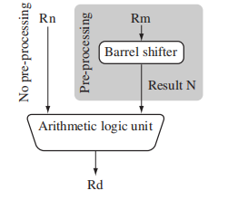
Barrel shifter and ALU :
Figure shows the data flow between the ALU and the barrel shifter. It adds a shift operation to the move instruction and Register Rn enters the ALU without any preprocessing of registers.
Notes:
9

Slide 10
Example : Apply a logical shift left (LSL) to register Rm before moving it to the destination register. This is the same as applying the standard C language shift operator to the register.
The MOV instruction copies the shift operator result N into register Rd. N represents the result of the LSL operation.
PRE r5 = 5
r7 = 8
MOV r7, r5, LSL #2 ; let r7 = r5*4 = (r5 << 2)
POST r5 = 5
r7 = 20
Above example multiplies register r5 by four and then places the result into register r7.

Slide 11
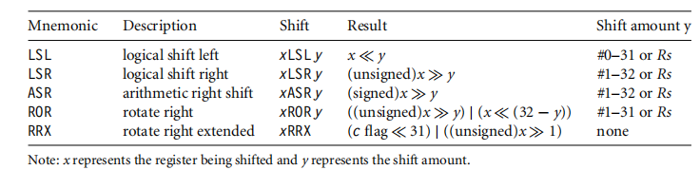
Five different shift operations that can be used within the barrel shifter are summarized below.
Barrel shifter operations:

Slide 12
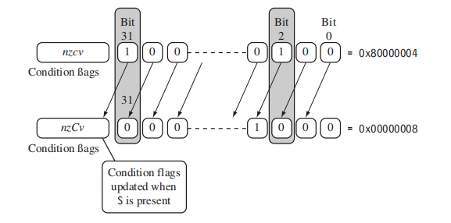
Logical shift left by one :
The contents of bit 0 are shifted to bit 1. Bit 0 is cleared.
The C flag is updated with the last bit shifted out of the register. This is bit (32 − y) of the original value, where y is the shift amount.
When y is greater than one, then a shift by y positions is the same as a shift by one position executed y times.

Slide 13
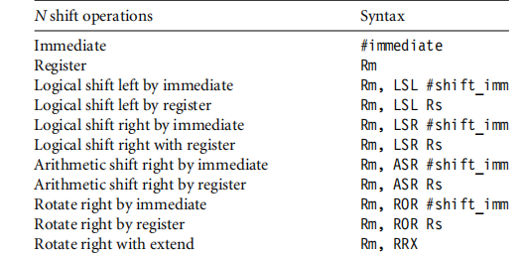
Barrel shift operation syntax for data processing instructions.

Slide 14
Example
This example is a MOVS instruction that shifts register r1 left by one bit. This multiplies register r1 by a value 21. As you can see, the C flag is updated in the cpsr because the S suffix is present in the instruction mnemonic.
PRE cpsr = nzcvqiFt_USER
r0 = 0x00000000
r1 = 0x80000004
MOVS r0, r1, LSL #1
POST cpsr = nzCvqiFt_USER
r0 = 0x00000008
r1 = 0x80000004
■
Above Table lists the syntax for the different barrel shift operations available on data processing instructions.
The second operand N can be an immediate constant preceded by #, a register value Rm, or the value of Rm processed by a shift.

Slide 15
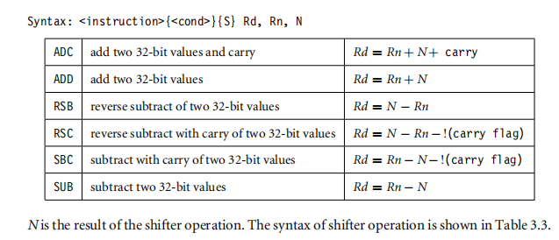
Arithmetic Instructions: The arithmetic instructions implement addition and subtraction of 32-bit signed and unsigned values.
Example : This simple subtract instruction subtracts a value stored in register r2 from a value stored in register r1. The result is stored in register r0.
PRE r0 = 0x00000000
r1 = 0x00000002
r2 = 0x00000001
SUB r0, r1, r2
POST r0 = 0x00000001

Slide 16
Example :This reverse subtract instruction (RSB) subtracts r1 from the constant value #0, writing the result to r0. You can use this instruction to negate numbers.
PRE r0 = 0x00000000
r1 = 0x00000077
RSB r0, r1, #0 ; Rd = 0x0 - r1
POST r0 = -r1 = 0xffffff89
Example : The SUBS instruction is useful for decrementing loop counters. In this example, we subtract the immediate value one from the value one stored in register r1. The result value zero is written to register r1. The cpsr is updated with the ZC flags being set.
PRE cpsr = nzcvqiFt_USER
r1 = 0x00000001
SUBS r1, r1, #1
POST cpsr = nZCvqiFt_USER
r1 = 0x00000000
■

Slide 17
Using the Barrel Shifter with Arithmetic Instructions
The wide range of second operand shifts available on arithmetic and logical instructions is a very powerful feature of the ARM instruction set. Example 3.7 illustrates the use of the inline barrel shifter with an arithmetic instruction. The instruction multiplies the value stored in register r1 by three.
Example : Register r1 is first shifted one location to the left to give the value of twice r1. The ADD instruction then adds the result of the barrel shift operation to register r1. The final result transferred into register r0 is equal to three times the value stored in register r1.
PRE r0 = 0x00000000
r1 = 0x00000005
ADD r0, r1, r1, LSL #1
POST r0 = 0x0000000f
r1 = 0x00000005

Slide 18
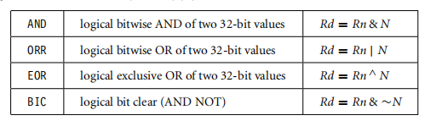
Logical Instructions:
Logical instructions perform bitwise logical operations on the two source registers.
Syntax: <instruction>{<cond>}{S} Rd, Rn, N
Example :This example shows a logical OR operation between registers r1 and r2. r0 holds the result.
PRE r0 = 0x00000000
r1 = 0x02040608
r2 = 0x10305070
ORR r0, r1, r2
POST r0 = 0x12345678

Slide 19
Example : This example shows a more complicated logical instruction called BIC, which carries out a logical bit clear.
PRE r1 = 0b1111
r2 = 0b0101
BIC r0, r1, r2
POST r0 = 0b1010
This is equivalent to Rd = Rn AND NOT(N).
In this example, register r2 contains a binary pattern where every binary 1 in r2 clears a corresponding bit location in register r1. This instruction is particularly useful when clearing status bits and is frequently used to change interrupt masks in the cpsr.
■ The logical instructions update the cpsr flags only if the S suffix is present. These instructions can use barrel-shifted second operands in the same way as the arithmetic instructions.

Slide 20
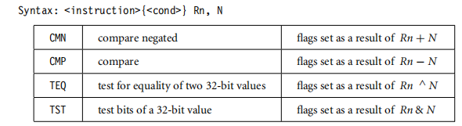
Comparison Instructions : The comparison instructions are used to compare or test a register with a 32-bit value. They update the cpsr flag bits according to the result, but do not affect other registers.
After the bits have been set, the information can then be used to change program flow by using conditional execution. For more information on conditional execution take a look at Section 3.8. You do not need to apply the S suffix for comparison instructions to update the flags. N is the result of the shifter operation

Slide 21
Example : This example shows a CMP comparison instruction. You can see that both registers, r0 and r9, are equal before executing the instruction. The value of the z flag prior to execution is 0 and is represented by a lowercase z. After execution the z flag changes to 1 or an uppercase Z. This change indicates equality.
PRE cpsr = nzcvqiFt_USER
r0 = 4
r9 = 4
CMP r0, r9
POST cpsr = nZcvqiFt_USER
The CMP is effectively a subtract instruction with the result discarded; similarly the TST instruction is a logical AND operation, and TEQ is a logical exclusive OR operation. For each, the results are discarded but the condition bits are updated in the cpsr. It is important to understand that comparison instructions only modify the condition flags of the cpsr and do not affect the registers being compared.

Slide 22

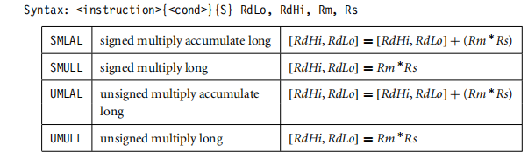
Multiply Instructions :
multiply instructions multiply the contents of a pair of registers and, depending upon the instruction, accumulate the results in with another register. The long multiplies accumulate onto a pair of registers representing a 64-bit value. The final result is placed in a destination register or a pair of registers.
Syntax: MLA{<cond>}{S} Rd, Rm, Rs, Rn
MUL{<cond>}{S} Rd, Rm, Rs

Slide 23
Example :This example shows a simple multiply instruction that multiplies registersr1 and r2 together and places the result into register r0. In this example, register r1 is equal to the value 2, and r2 is equal to 2. The result, 4, is then placed into register r0.
PRE r0 = 0x00000000
r1 = 0x00000002
r2 = 0x00000002
MUL r0, r1, r2 ; r0 = r1*r2
POST r0 = 0x00000004
r1 = 0x00000002
r2 = 0x00000002
■ The long multiply instructions (SMLAL, SMULL, UMLAL, and UMULL) produce a 64-bit result. The result is too large to fit a single 32-bit register so the result is placed in two registers labeled RdLo and RdHi. RdLo holds the lower 32 bits of the 64-bit result, and RdHi holds the higher 32 bits of the 64-bit result. Example 3.12 shows an example of a long unsigned multiply instruction.

Slide 24
Example: The instruction multiplies registers r2 and r3 and places the result into register r0 and r1. Register r0 contains the lower 32 bits, and register r1 contains the higher 32 bits of the 64-bit result.
PRE r0 = 0x00000000
r1 = 0x00000000
r2 = 0xf0000002
r3 = 0x00000002
UMULL r0, r1, r2, r3 ; [r1,r0] = r2*r3
POST r0 = 0xe0000004 ; = RdLo
r1 = 0x00000001 ; = RdHi

Slide 25
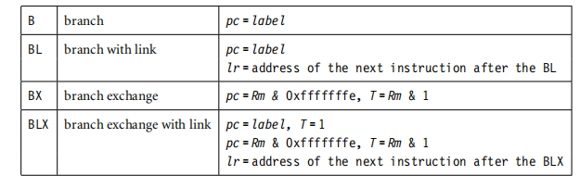
Branch Instructions
A branch instruction changes the flow of execution or is used to call a routine. This type of instruction allows programs to have subroutines, if-then-else structures, and loops.
The change of execution flow forces the program counter pc to point to a new address. The ARMv5E instruction set includes four different branch instructions.
Syntax: B{<cond>} label
BL{<cond>} label
BX{<cond>}
BLX{<cond>} label | Rm

Slide 26
The address label is stored in the instruction as a signed pc-relative offset and must be within approximately 32 MB of the branch instruction.
Example : It shows a forward and backward branch. The forward branch skips three instructions. The backward branch creates an infinite loop.
B forward
ADD r1, r2, #4
ADD r0, r6, #2
ADD r3, r7, #4
forward
SUB r1, r2, #4
backward
ADD r1, r2, #4
SUB r1, r2, #4
ADD r4, r6, r7
B backward

Slide 27
The branch with link, or BL, instruction is similar to the B instruction but overwrites the link register lr with a return address.
It performs a subroutine call. This example shows a simple fragment of code that branches to a subroutine using the BL instruction.
To return from a subroutine, you copy the link register to the pc.
BL subroutine ; branch to subroutine
CMP r1, #5 ; compare r1 with 5
MOVEQ r1, #0 ; if (r1==5) then r1 = 0
:
subroutine
<subroutine code>
MOV pc, lr ; return by moving pc = lr

Slide 28
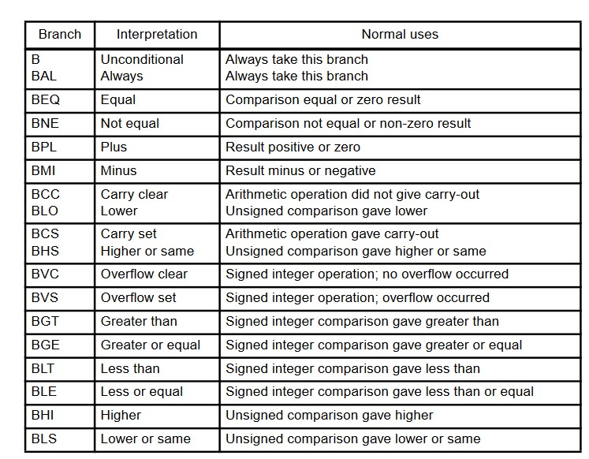

Slide 29
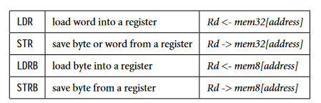
Load-Store Instructions:
Load-store instructions transfer data between memory and processor registers. There are three types of load-store instructions: single-register transfer, multiple-register transfer, and swap.
Single-Register Transfer:
These instructions are used for moving a single data item in and out of a register. The datatypes supported are signed and unsigned words (32-bit), halfwords (16-bit), and bytes.
Here are the various load-store single-register transfer instructions.
Syntax: <LDR|STR>{<cond>}{B} Rd,addressing1
LDR{<cond>}SB|H|SH Rd, addressing2
STR{<cond>}H Rd, addressing2

Slide 30
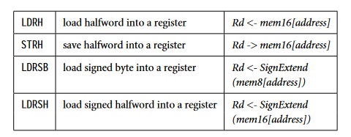

Slide 31
LDR and STR instructions can load and store data on a boundary alignment that is the same as the datatype size being loaded or stored. For example, LDR can only load 32-bit words on a memory address that is a multiple of four bytes—0, 4, 8, and so on. This example shows a load from a memory address contained in register r1, followed by a store back to the same address in memory.
Example : LDR r0, [r1] ; load register r0 with the contents of the memory address pointed to by register r1.
Example : STR r0, [r1] ; store the contents of register r0 to the memory address pointed to by register r1.
The first instruction loads a word from the address stored in register r1 and places it into register r0. The second instruction goes the other way by storing the contents of register r0 to the address contained in register r1.

Slide 32
Single register loads and stores
The simplest form is just register indirect:
LDR r0, [r1] ; r0 := mem[r1]
This is a special form of base plus offset:
LDR r0, [r1,#4] ; r0 := mem[r1+4]
The offset is within 4 Kbytes
Auto-indexing is also possible:
LDR r0, [r1,#4]! ; r0 := mem[r1+4]
; r1 := r1 + 4

Slide 33
Multiple register loads and stores
ARM also supports instructions which transfer several registers:
LDMIA r1, {r0,r2,r5} ; r0 := mem[r1]
; r2 := mem[r1+4]
; r5 := mem[r1+8]
– the {…} list may contain any or all of r0 - r15
– the lowest register always uses the lowest address, and so on, in increasing order
– it doesn’t matter how the registers are ordered in {…}

Slide 34
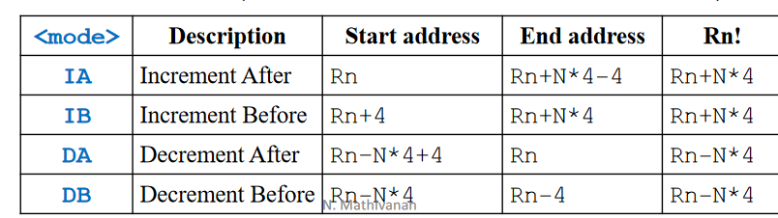
Multiple Load-Store Instructions
• Transfers data between multiple regs & mem in single instruction
• Instructions: LDM and STM
• Use: stack, block move, temporary store & restore
• Advantages: small code size, single instruction fetch from memory
• Disadvantages: can’t be interrupted, increases interrupt latency
• Syntax:
<opcode>{<cond>}<mode>Rn{!},<registers>
Rn – Base register, ‘!’ update base reg. after data transfer (option)

Slide 35
Example : In this example, register r0 is the base register Rn and is followed by !, indicating that the register is updated after the instruction is executed. You will notice within the load multiple instruction that the registers are not individually listed. Instead the “-” character is used to
identify a range of registers. In this case the range is from register r1 to r3 inclusive.
Each register can also be listed, using a comma to separate each register within “{” and “}” brackets.
PRE mem32[0x80018] = 0x03
mem32[0x80014] = 0x02
mem32[0x80010] = 0x01
r0 = 0x00080010
r1 = 0x00000000
r2 = 0x00000000
r3 = 0x00000000
LDMIA r0!, {r1-r3}
POST r0 = 0x0008001c
r1 = 0x00000001
r2 = 0x00000002
r3 = 0x00000003

Slide 36
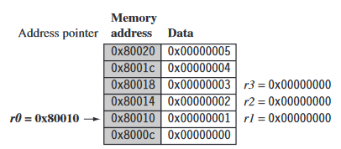
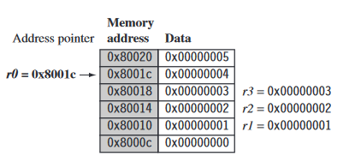
Pre-condition for LDMIA instruction
The base register r0 points to memory address 0x80010 in the PRE condition. Memory addresses 0x80010, 0x80014, and 0x80018 contain the values 1, 2, and 3 respectively. After the load multiple instruction executes registers r1, r2, and r3 contain these values as shown in Figure below. The base register r0 now points to memory address 0x8001c after the last loaded word.
Post-condition for LDMIA instruction

Slide 37
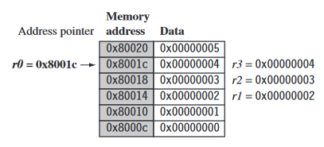
Post-condition for LDMIB instruction
Now replace the LDMIA instruction with a LDMIB instruction ( load multiple and increment before) and use the same PRE conditions. The first word pointed to by register r0 is ignored and register r1 is loaded from the next memory location as shown in Figure below.
After execution, register r0 now points to the last loaded memory location. This is in contrast with the LDMIA example, which pointed to the next memory location.

Slide 38
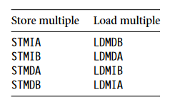
Load-store multiple pairs when base update used
Table above shows a list of load-store multiple instruction pairs. If you use a store with base update, then the paired load instruction of the same number of registers will reload the data and restore the base address pointer. This is useful when you need to temporarily save a group of registers and restore them later.
This example shows an STM increment before instruction
PRE r0 = 0x00009000 STMIB r0!, {r1-r3}
MOV r1, #1 r1 = 0x00000009
MOV r2, #2 r2 = 0x00000008
MOV r3, #3 r3 = 0x00000007

Slide 39
LDM decrement after instruction.
PRE(2) r0 = 0x0000900c
r1 = 0x00000001
r2 = 0x00000002
r3 = 0x00000003
LDMDA r0!, {r1-r3}
POST r0 = 0x00009000
r1 = 0x00000009
r2 = 0x00000008
r3 = 0x00000007
The STMIB instruction stores the values 7, 8, 9 to memory. We then corrupt register r1 to r3.
The LDMDA reloads the original values and restores the base pointer r0.

Slide 40
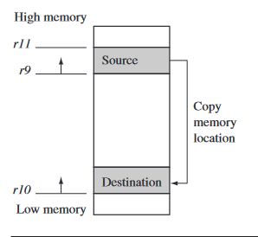
Block memory copy in the memory map
It can transfer 32 bytes (8 words) in two instructions. The example has two load-store multiple instructions, which use the same increment after addressing mode.
LDMIA r9!, {r0-r7}
STMIA r10!, {r0-r7}

Slide 41
r9 points to start of source data
r10 points to start of destination data
r11 points to end of the source
loop
; load 32 bytes from source and update r9 pointer
; store 32 bytes to destination and update r10 pointer
CMP r9, r11
BNE loop
Registers r9 and r11 determine the data to be copied, and register r10 points to the destination in memory for the data.
Procedure:
LDMIA loads the data pointed to by register r9 into registers r0 to r7
It also updates r9 to point to the next block of data to be copied.
STMIA copies the contents of registers r0 to r7 to the destination memory address pointed to by register r10.
It also updates r10 to point to the next destination location.
CMP and BNE compare pointers r9 and r11 to check whether the end of the block copy has been reached.
If the block copy is complete, then the routine finishes; otherwise the loop repeats with the updated values of register r9 and r10.

Slide 42
Stack Operations
The ARM architecture uses the load-store multiple instructions to carry out stack operations.
Load multiple instruction is used for Pop.
Store multiple instruction is used for Push.
When using a stack you have to decide whether the stack will grow up or down in memory.
A stack is either ascending (A) or descending (D). Ascending stacks grow towards higher memory addresses; in contrast, descending stacks grow towards lower memory addresses.
When you use a full stack (F), the stack pointer sp points the last item on the stack. In contrast, if you use an empty stack (E) the sp points to an address that is the first unused or empty location (i.e., it points after the last item on the stack).

Slide 43
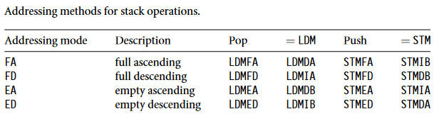
There are a number of load-store multiple addressing mode aliases available to support stack operations as shown in Table below.
Next to the pop column is the actual load multiple instruction equivalent. For example, a full ascending stack would have the notation FA appended to the load multiple instruction—LDMFA. This would be translated into an LDMDA instruction.

Slide 44
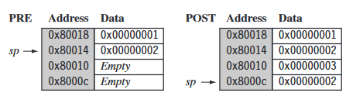
STMFD instruction—full stack push operation.
Example : The STMFD instruction pushes registers onto the stack, updating the sp. Figure shows a push onto a full descending stack. You can see that when the stack grows the stack pointer points to the last full entry in the stack.
PRE r1 = 0x00000002
r4 = 0x00000003
sp = 0x00080014
STMFD sp!, {r1,r4}
POST r1 = 0x00000002
r4 = 0x00000003
sp = 0x0008000c

Slide 45
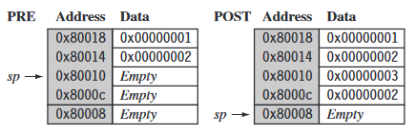
Push operation on an empty stack :
The STMED instruction pushes the registers onto the stack but updates register sp to point to the next empty location.
PRE r1 = 0x00000002
r4 = 0x00000003
sp = 0x00080010
STMED sp!, {r1,r4}
POST r1 = 0x00000002
r4 = 0x00000003
sp = 0x00080008

Slide 46
When handling a checked stack there are three attributes that need to be preserved:
Stack base: starting address of the stack in memory.
Stack pointer : points to the stack base; as data is pushed onto the stack, the stack pointer descends memory and continuously points to the top of stack.
Stack limit : If the stack pointer passes the stack limit, then a stack overflow error has occurred.
This small piece of code checks for stack overflow errors for a descending stack:
SUB sp, sp, #size
CMP sp, r10
BLLO _stack_overflow ; condition
The BLLO instruction is a branch with link instruction plus the
condition mnemonic LO.
If sp is less than register r10 after the new items are pushed onto the stack, then stack overflow error has occurred.
If the stack pointer goes back past the stack base, then a stack underflow error has occurred.

Slide 47
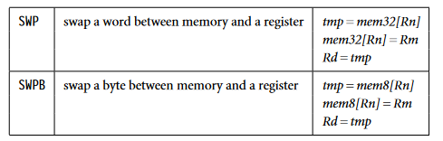
Swap Instruction
The swap instruction is a special case of a load-store instruction. It swaps the contents of memory with the contents of a register. This instruction is an atomic operation—it reads and writes a location in the same bus operation, preventing any other instruction from reading or writing to that location until it completes.
Syntax: SWP{B}{<cond>} Rd,Rm,[Rn]
Swap cannot be interrupted by any other instruction or any other bus access. We say the system “holds the bus” until the transaction is complete.

Slide 48
Example: The swap instruction loads a word from memory into register r0 and overwrites the memory with register r1. ( Load R0 with the word addressed by R2, and store R1 at R2.)
PRE
mem32[0x9000] = 0x12345678
r0 = 0x00000000
r1 = 0x11112222
r2 = 0x00009000
SWP r0, r1, [r2]
POST
mem32[0x9000] = 0x11112222
r0 = 0x12345678
r1 = 0x11112222
r2 = 0x00009000
This instruction is particularly useful when implementing semaphores and mutual exclusion in an operating system. You can see from the syntax that this instruction can also have a byte size qualifier B, so this instruction allows for both a word and a byte swap.

Slide 49
This example shows a simple data guard that can be used to protect data from being written by another task. The SWP instruction “holds the bus” until the transaction is complete.
spin
MOV r1, =semaphore
MOV r2, #1
SWP r3, r2, [r1] ; hold the bus until complete
CMP r3, #1
BEQ spin
The address pointed to by the semaphore either contains the value 0 or 1. When the semaphore equals 1, then the service in question is being used by another process. The routine will continue to loop around until the service is released by the other process—in other words, when the semaphore address location contains the value 0.

Slide 50
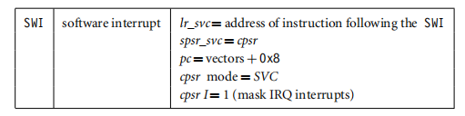
Software Interrupt Instruction
A software interrupt instruction (SWI) causes a software interrupt exception, which provides a mechanism for applications to call operating system routines.
Syntax: SWI{<cond>} SWI_number
When the processor executes an SWI instruction, it sets the program counter pc to the offset 0x8 in the vector table.
It also forces the processor mode to SVC, which allows an operating system routine to be called in a privileged mode.
Each SWI instruction has an associated SWI number, which is used to represent a particular function call or feature.

Slide 51
Example
It shows an SWI call with SWI number 0x123456,. Typically the SWI instruction is executed in user mode.
PRE
cpsr = nzcVqi ft_USER
pc = 0x00008000
lr = 0x003fffff ; lr = r14
r0 = 0x12
0x00008000 SWI 0x123456
POST
cpsr = nzcVqIft_SVC
spsr = nzcVqi ft_USER
pc = 0x00000008
lr = 0x00008004
r0 = 0x12

Slide 52
Since SWI instructions are used to call operating system routines, we need some form of parameter passing. This is achieved using registers. In this example, register r0 is used to pass the parameter 0x12. The return values are also passed back via registers.
Code called the SWI handler is required to process the SWI call. The handler obtains the SWI number using the address of the executed instruction, which is calculated from the link register lr.
The SWI number is determined by
SWI_Number = <SWI instruction> AND NOT(0xff000000)
Here the SWI instruction is the actual 32-bit SWI instruction executed by the processor.

Slide 53
Example : This example shows the start of an SWI handler implementation. The code fragment determines what SWI number is being called and places that number into register r10. You can see from this example that the load instruction first copies the complete SWI instruction into register r10. The BIC instruction masks off the top bits of the instruction, leaving the SWI number. We assume the SWI has been called from ARM state.
SWI_handler
STMFD sp!, {r0-r12, lr} ; Store registers r0-r12 and the link register
LDR r10, [lr, #-4] ; Read the SWI instruction
BIC r10, r10, #0xff000000 ; Mask off top 8 bits
; r10 - contains the SWI number
BL service_routine ; return from SWI handler
LDMFD sp!, {r0-r12, pc}ˆ
The number in register r10 is then used by the SWI handler to call the appropriate SWI service routine.

Slide 54
Program Status Register Instructions
The ARM instruction set provides two instructions to directly control a program status register (psr).
The MRS instruction transfers the contents of either the cpsr or spsr into a register in the reverse direction.
The MSR instruction transfers the contents of a register into the cpsr or spsr.
Together these instructions are used to read and write the cpsr and spsr.
In the syntax you can see a label called fields. This can be any combination of control (c), extension (x), status (s), and flags (f ). These fields relate to particular byte regions in a psr, as shown in Figure below.
Syntax: MRS{<cond>} Rd,<cpsr|spsr>
MSR{<cond>} <cpsr|spsr>_<fields>,Rm
MSR{<cond>} <cpsr|spsr>_<fields>,#immediate

Slide 55
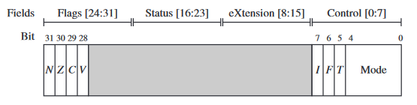
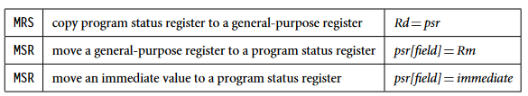
PSR byte fields :
The c field controls the interrupt masks, Thumb state, and processor mode

Slide 56

Loading Constants :
There is no ARM instruction to move a 32-bit constant into a register. Since ARM instructions are 32 bits in size, they obviously cannot specify a general 32-bit constant.
To aid programming there are two pseudo instructions to move a 32-bit value into a register.
Syntax: LDR Rd, =constant
ADR Rd, label
The first pseudo instruction writes a 32-bit constant to a register using whatever instructions are available. It defaults to a memory read if the constant cannot be encoded using other instructions.
The second pseudo instruction writes a relative address into a register, which will be encoded using a pc-relative expression.

Slide 57
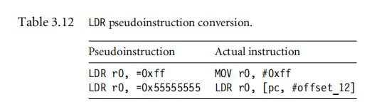
Example
This example shows an LDR instruction loading a 32-bit constant 0xff00ffff into register r0.
LDR r0, [pc, #constant_number-8-{PC}]
:
constant_number
DCD 0xff00ffff
This example involves a memory access to load the constant, which can be expensive for time-critical routines.
■ Below Example shows an alternative method to load the same constant into register r0 by using an MVN instruction.

Slide 58
Example
Loading the constant 0xff00ffff using an MVN.
PRE
none...
MVN r0, #0x00ff0000
POST
r0 = 0xff00ffff
There are no of alternatives to accessing memory, but they depend upon the constant you are trying to load. The LDR pseudoinstruction either inserts an MOV or MVN instruction to generate a value (if possible) or generates an LDR instruction with a pc-relative address to read the constant from a literal pool—a data area embedded within the code.
Above Table shows two pseudocode conversions.
The first conversion produces a simple MOV instruction;
The second conversion produces a pc-relative load.
Another useful pseudo instruction is the ADR instruction, or address relative. This instruction places the address of the given label into register Rd, using a pc-relative add or subtract.

Slide 59
Overview of C Compilers and Optimization :
C compilers have to translate your C function literally into assembler so that it works for all possible inputs. In practice, many of the input combinations are not possible or won’t occur. Let’s start by looking at an example of the problems the compiler faces. The memclr function clears N bytes of memory at address data.
void memclr(char *data, int N)
{
for (; N>0; N--)
{
*data=0;
data++;
}
}

Slide 60
No matter how advanced the compiler, it does not know whether N can be 0 on input or not. Therefore the compiler needs to test for this case explicitly before the first iteration of the loop.
The compiler doesn’t know whether the data array pointer is four-byte aligned or not.
If it is four-byte aligned, then the compiler can clear four bytes at a time using an int store rather than a char store. Nor does it know whether N is a multiple of four or not. If N is a multiple of four, then the compiler can repeat the loop body four times or store four bytes at a time using an int store.
Basic C Data Types
ARM processors have 32-bit registers and 32-bit data processing operations. The ARM architecture is a RISC load/store architecture. In other words you must load values from memory into registers before acting on them. There are no arithmetic or logical instructions that manipulate values in memory directly.

Slide 61
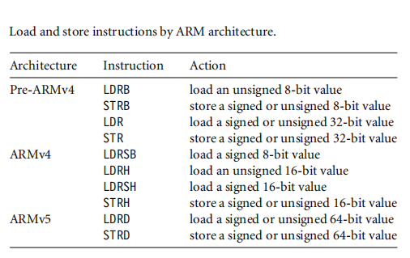
Load instruction that act on 8- or 16-bit values extend the value to 32 bits before writing to an ARM register.
Unsigned values are zero-extended, and signed values sign-extended.

Slide 62
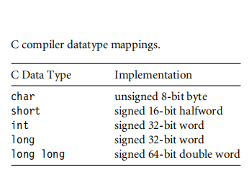
Local Variable Types
Most ARM data processing operations are 32-bit only. For this reason, we should use a 32-bit datatype, int or long, for local variables wherever possible.
Avoid using char and short as local variable types, even if you are manipulating an 8- or 16-bit value.
The one exception is when you want wrap-around to occur. If you require modulo arithmetic of the form 255 + 1 = 0, then use the char type.

Slide 63
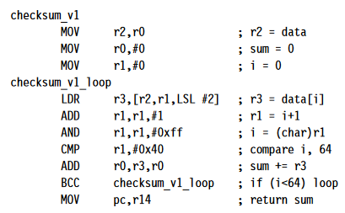
Example : The following code checksums a data packet containing 64 words. It shows why you should avoid using char for local variables.
int checksum_v1(int *data)
{
char i;
int sum = 0;
for (i = 0; i < 64; i++)
{
sum += data[i];
}
return sum;
}
Declaring any variable as a char is not efficient and it does not uses less register space or less space on the ARM stack than an int.

Slide 64
All ARM registers are 32-bit and all stack entries are at least 32-bit. Furthermore, to implement the i++ exactly, the compiler must account for the case when i = 255. Any attempt to increment 255 should produce the answer 0.
Consider the compiler output for this function. We’ve added labels and comments to make the assembly clear.
checksum_v1
MOV r2,r0 ; r2 = data
MOV r0,#0 ; sum = 0
MOV r1,#0 ;i=0
checksum_v1_loop
LDR r3,[r2,r1,LSL #2] ; r3 = data[i]
ADD r1,r1,#1 ; r1 = i+1
AND r1,r1,#0xff ; i = (char)r1
CMP r1,#0x40 ; compare i, 64
ADD r0,r3,r0 ; sum += r3
BCC checksum_v1_loop ; if (i<64) loop (Branch if carry is clear)
MOV pc,r14 ; return sum

Slide 65
Now compare this to the compiler output where instead we declare i as an unsigned int.
checksum_v2
MOV r2,r0 ; r2 = data
MOV r0,#0 ; sum = 0
MOV r1,#0 ;i=0
checksum_v2_loop
LDR r3,[r2,r1,LSL #2] ; r3 = data[i]
ADD r1,r1,#1 ; r1++
CMP r1,#0x40 ; compare i, 64
ADD r0,r3,r0 ; sum += r3
BCC checksum_v2_loop ; if (i<64) goto loop
MOV pc,r14 ; return sum

Slide 66
In the first case, the compiler inserts an extra AND instruction to reduce i to the range 0 to 255 before the comparison with 64. This instruction disappears in the second case.
Next, suppose the data packet contains 16-bit values and we need a 16-bit checksum. It is tempting to write the following C code:
short checksum_v3(short *data)
{
unsigned int i;
short sum = 0;
for (i = 0; i < 64; i++)
{
sum = (short)(sum + data[i]);
}
return sum;
}
You may wonder why the for loop body doesn’t contain the code
sum += data[i]

Slide 67
The expression sum + data[i] is an integer and so can only be assigned to a short using an (implicit or explicit) narrowing cast. As you can see in the following assembly output, the compiler must insert extra instructions to implement the narrowing cast:
checksum_v3
MOV r2,r0 ; r2 = data
MOV r0,#0 ; sum = 0
MOV r1,#0 ;i=0
checksum_v3_loop
ADD r3,r2,r1,LSL #1 ; r3 = &data[i]
LDRH r3,[r3,#0] ; r3 = data[i]
ADD r1,r1,#1 ; i++
CMP r1,#0x40 ; compare i, 64
ADD r0,r3,r0 ; r0 = sum + r3
MOV r0,r0,LSL #16
MOV r0,r0,ASR #16 ; sum = (short)r0
BCC checksum_v3_loop ; if (i<64) goto loop
MOV pc,r14 ; return sum

Slide 68
There are two reasons for the extra instructions:
■ The LDRH instruction does not allow for a shifted address offset as the LDR instruction did in checksum_v2. Therefore the fifirst ADD in the loop calculates the address of item i in the array. The LDRH loads from an address with no offset. LDRH has fewer addressing
modes than LDR as it was a later addition to the ARM instruction set. (See Table 5.1.)
■ The cast reducing total + array[i] to a short requires two MOV instructions. The compiler shifts left by 16 and then right by 16 to implement a 16-bit sign extend. The shift right is a sign-extending shift so it replicates the sign bit to fill the upper 16 bits.
We can avoid the second problem by using an int type variable to hold the partial sum.
We only reduce the sum to a short type at the function exit.

Slide 69
Example
The checksum_v4 code fixes all the problems we have discussed in this section. It uses int type local variables to avoid unnecessary casts. It increments the pointer data instead of using an index offset data[i].
short checksum_v4(short *data)
{
unsigned int i;
int sum=0;
for (i=0; i<64; i++)
{
sum += *(data++);
}
return (short)sum;
}
The *(data++) operation translates to a single ARM instruction that loads the data and increments the data pointer. Of course you could write sum += *data; data++; or even *data++ instead if you prefer. The compiler produces the following output. Three instructions have been removed from the inside loop, saving three cycles per loop compared to
checksum_v3.

Slide 70
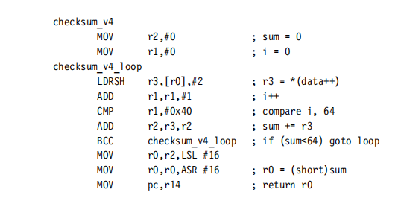

Slide 71
Function Argument Types :
converting local variables from types char or short to type int increases performance and reduces code size. The same holds for function arguments.
Consider the following simple function, which adds two 16-bit values, halving the second, and returns a 16-bit sum:
short add_v1(short a, short b)
{
return a + (b >> 1);
}
This function is a little artificial, but it is a useful test case to illustrate the problems faced by the compiler. The input values a, b, and the returnvalue will be passed in 32-bit ARM registers. Should the compiler assume that these 32-bit values are in the range of
a short type, that is, −32,768 to +32,767? Or should the compiler force values to be in this range by sign-extending the lowest 16 bits to fifill the 32-bit register? The compiler must make compatible decisions for the function caller and callee.

Slide 72
Signed versus Unsigned Types :
The previous sections demonstrate the advantages of using int rather than a char or short type for local variables and function arguments. This section compares the efficiencies of signed int and unsigned int.
If your code uses addition, subtraction, and multiplication, then there is no performance difference between signed and unsigned operations. However, there is a difference when it comes to division. Consider the following short example that averages two integers:
int average_v1(int a, int b)
{
return (a+b)/2;
}
This compiles to average_v1
ADD r0,r0,r1 ; r0=a+b
ADD r0,r0,r0,LSR #31 ; if (r0<0) r0++
MOV r0,r0,ASR #1 ; r0 = r0 >> 1
MOV pc,r14 ; return r0
Notice that the compiler adds one to the sum before shifting by right if the sum is negative. In other words it replaces x/2 by the statement:
(x<0) ? ((x+1) >> 1): (x >> 1)

Slide 73
C Looping Structures
Loops with a Fixed Number of Iterations : Example
int checksum_v5(int *data)
{
unsigned int i;
int sum=0;
for (i=0; i<64; i++)
{
sum += *(data++);
}
return sum;
}
This compiles to
checksum_v5
MOV r2,r0 ; r2 = data
MOV r0,#0 ; sum = 0
MOV r1,#0 ; i=0
checksum_v5_loop
LDR r3,[r2],#4 ; r3 = *(data++)
ADD r1,r1,#1 ; i++
CMP r1,#0x40 ; compare i, 64
ADD r0,r3,r0 ; sum += r3
BCC checksum_v5_loop ; if (i<64) goto loop
MOV pc,r14 ; return sum

Slide 74
It takes three instructions to implement the for loop structure:
An ADD to increment i
A compare to check if i is less than 64
A conditional branch to continue the loop if i < 64
This is not efficient. On the ARM, a loop should only use 2 instructions:
A subtract to decrement the loop counter, which also sets the condition code flags on the result
A conditional branch instruction
The key point is that the loop counter should count down to zero rather than counting up to some arbitrary limit. Then the comparison with zero is free since the result is stored in the condition flags. Since we are no longer using i as an array index, there is no problem in counting down rather than up.
Example
This example shows the improvement if we switch to a decrementing loop rather than an incrementing loop.
int checksum_v6(int *data)
{
unsigned int i;
int sum=0;
for (i=64; i!=0; i--)
{
sum += *(data++);
}
return sum;
}

Slide 75
This compiles to checksum_v6
MOV r2,r0 ; r2 = data
MOV r0,#0 ; sum = 0
MOV r1,#0x40 ; i = 64
checksum_v6_loop
LDR r3,[r2],#4 ; r3 = *(data++)
SUBS r1,r1,#1 ; i-- and set flags
ADD r0,r3,r0 ; sum += r3
BNE checksum_v6_loop ; if (i!=0) goto loop
MOV pc,r14 ; return sum
The SUBS and BNE instructions implement the loop. Our checksum example now has the minimum number of four instructions per loop. This is much better than six for checksum_v1 and eight for checksum_v3.

Slide 76
Loops Using a Variable Number of Iterations
Now suppose we want our checksum routine to handle packets of arbitrary size. We pass in a variable N giving the number of words in the data packet. Using the lessons from the last section we count down until N = 0 and don’t require an extra loop counter i.
The checksum_v7 example shows how the compiler handles a for loop with a variable number of iterations N.
int checksum_v7(int *data, unsigned int N)
{
int sum=0;
for (; N!=0; N--)
{
sum += *(data++);
}
return sum;
}
This compiles to
checksum_v7
MOV r2,#0 ; sum = 0
CMP r1,#0 ; compare N, 0
BEQ checksum_v7_end ; if (N==0) goto end

Slide 77
checksum_v7_loop
LDR r3,[r0],#4 ; r3 = *(data++)
SUBS r1,r1,#1 ; N-- and set flags
ADD r2,r3,r2 ; sum += r3
BNE checksum_v7_loop ; if (N!=0) goto loop
checksum_v7_end
MOV r0,r2 ; r0 = sum
MOV pc,r14 ; return r0
Loop Unrolling
Each loop iteration costs two instructions in addition to the body of the loop: a subtract to decrement the loop count and a conditional branch.
These instructions are known as the loop overhead. On ARM7 or ARM9 processors the subtract takes one cycle and the branch three cycles, giving an overhead of four cycles per loop.
You can save some of these cycles by unrolling a loop—repeating the loop body several times, and reducing the number of loop iterations by the same proportion. For example, let’s unroll our packet checksum example four times.

Slide 78
Example
The following code unrolls our packet checksum loop by four times. We assume that the number of words in the packet N is a multiple of four.
int checksum_v9(int *data, unsigned int N)
{
int sum=0;
do
{
sum += *(data++);
sum += *(data++);
sum += *(data++);
Sum += *(data++);
N -= 4;
} while ( N!=0);
return sum;
}

Slide 79
This compiles to
checksum_v9
MOV r2,#0 ; sum = 0
checksum_v9_loop
LDR r3,[r0],#4 ; r3 = *(data++)
SUBS r1,r1,#4; N -= 4 & set flags
ADD r2,r3,r2 ; sum += r3
LDR r3,[r0],#4 ; r3 = *(data++)
ADD r2,r3,r2 ; sum += r3
LDR r3,[r0],#4 ; r3 = *(data++)
ADD r2,r3,r2 ; sum += r3
LDR r3,[r0],#4 ; r3 = *(data++)
ADD r2,r3,r2 ; sum += r3
BNE checksum_v9_loop ; if (N!=0) goto loop
MOV r0,r2 ; r0 = sum
MOV pc,r14 ; return r0

Slide 80
Example
This example handles the checksum of any size of data packet using a loop that has been unrolled four times.
int checksum_v10(int *data, unsigned int N)
{
unsigned int i;
int sum=0;
for (i=N/4; i!=0; i--)
{
sum += *(data++);
sum += *(data++);
sum += *(data++);
sum += *(data++);
}
for (i=N&3; i!=0; i--)
{
sum += *(data++);
}
return sum;
}

Slide 81
Register Allocation :
The compiler attempts to allocate a processor register to each local variable you use in a C function. It will try to use the same register for different local variables if the use of the variables do not overlap. When there are more local variables than available registers, the compiler stores the excess variables on the processor stack. These variables are called spilled
or swapped out variables since they are written out to memory (in a similar way virtual memory is swapped out to disk). Spilled variables are slow to access compared to variables allocated to registers.
To implement a function efficiently, you need to
■ minimize the number of spilled variables
■ ensure that the most important and frequently accessed variables are stored in registers

Slide 82
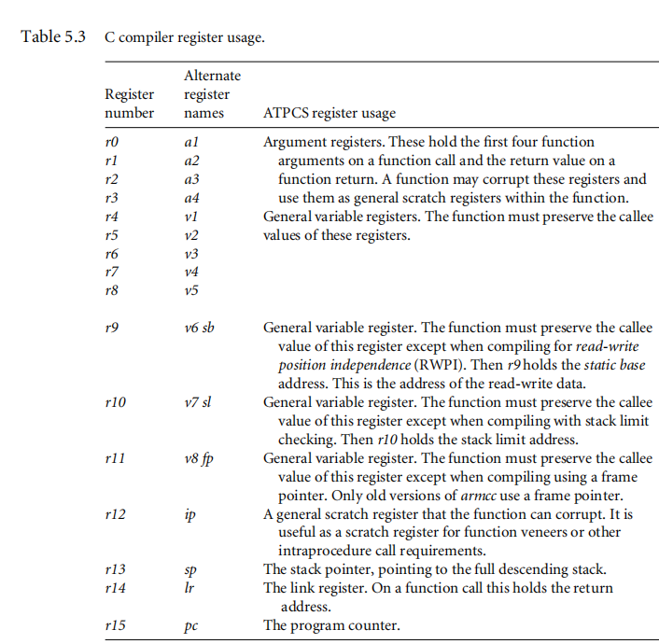

Slide 83
Pointer Aliasing
Two pointers are said to alias when they point to the same address. If you write to one pointer, it will affect the value you read from the other pointer. In a function, the compiler often doesn’t know which pointers can alias and which pointers can’t. The compiler must be very pessimistic and assume that any write to a pointer may affect the value read from any other pointer, which can significantly reduce code efficiency.
The following function increments two timer values by a step amount:
void timers_v1(int *timer1, int *timer2, int *step)
{
*timer1 += *step;
*timer2 += *step;
}
This compiles to
timers_v1
LDR r3,[r0,#0] ; r3 = *timer1
LDR r12,[r2,#0] ; r12 = *step
ADD r3,r3,r12 ; r3 += r12
STR r3,[r0,#0] ; *timer1 = r3
LDR r0,[r1,#0] ; r0 = *timer2
LDR r2,[r2,#0] ; r2 = *step
ADD r0,r0,r2 ; r0 += r2
STR r0,[r1,#0] ; *timer2 = t0
MOV pc,r14 ; return

Slide 84
Note that the compiler loads from step twice. Usually a compiler optimization called common subexpression elimination would kick in so that *step was only evaluated once, nd the value reused for the second occurrence. The pointers timer1and step might alias one another. In other words, the compiler cannot be sure that the write to timer1 doesn’t affect the read from step.
The following code also compiles inefficiently:
typedef struct {int step;} State;
typedef struct {int timer1, timer2;} Timers;
void timers_v2(State *state, Timers *timers)
{
timers->timer1 += state->step;
timers->timer2 += state->step;
}
The compiler evaluates state->step twice in case state->step and timers->timer1 are at the same memory address. The fix is easy: Create a new local variable to hold the value of state->step so the compiler only performs a single load.

